Slide 1
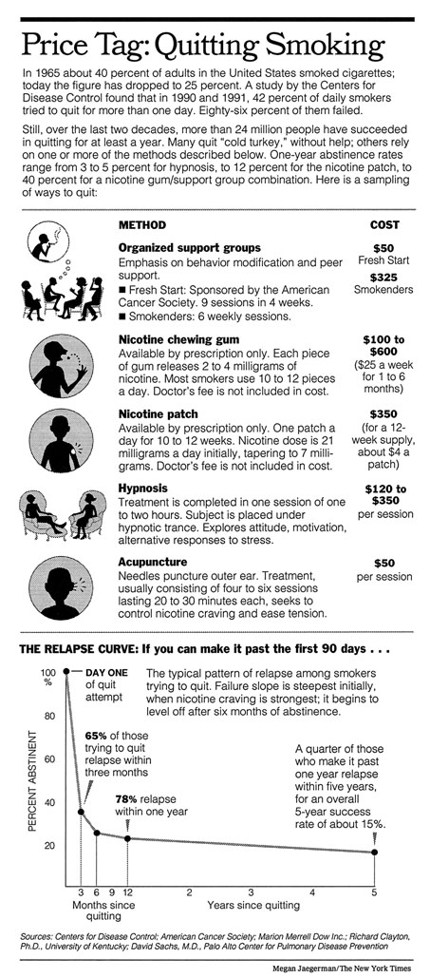

Slide 2

P peline
The Data
Information Visualization
© Jennifer Mankoff
The Data Pipeline; HCII; Spring 2014
Slides cribbed from Marti Hearst http://courses.ischool.berkeley.edu/i247/f05/ (slides 2-10, 16, 19-21, 23, 25-37); Jian Huang, based on a tutorial by Daniel Kiem (slides 39-58); Beomjin Kin (11-14, 17-18)

Slide 3
Goals for today
Talk Narrative
Finish D3
Review ‘Quiz’
Another Quiz
Discuss Byte 4
Possible case study

Slide 4
Definition of Narrative
“an account of a series of events, facts, etc., given in order and with the establishing of connections between them.”
-- Oxford English Dictionary
Beginning, Middle, End: Conflict & Conflict Resolution

Slide 5
Holistic Design Goals
Data & View Specifications | Visualize (choose encoding) Filter (focus on relevant items) Sort (expose patterns) Derive values or models
View Manipulation | Select (to highlight, filter, or manipulate) Navigate (zoom to examine patterns & detail) Coordinate (linked exploration) Organize windows and workspaces.
Process & Provenance | Record analysis histories Annotate patterns to document findings. Share views and annotations Guide users through analysis tasks or stories.
Heer & Shneiderman: Interactive Dynamics for Visual Analysis; ACM QUEUE, Feb 20, 2012
Notes:
Xx http://flowingdata.com/2016/01/19/how-you-will-die/
Tailor to the application and the domain
Create highly interactive and integrated systems
Embed the visualization within a larger application
Provide alternative views

Slide 6
Holistic Design Goals
Data & View Specifications | Visualize (choose encoding) Filter (focus on relevant items) Sort (expose patterns) Derive values or models
View Manipulation | Select (to highlight, filter, or manipulate) Navigate (zoom to examine patterns & detail) Coordinate (linked exploration) Organize windows and workspaces.
Process & Provenance | Record analysis histories Annotate patterns to document findings. Share views and annotations Guide users through analysis tasks or stories.
Heer & Shneiderman: Interactive Dynamics for Visual Analysis; ACM QUEUE, Feb 20, 2012

Slide 7

Rzeszotarski & Kittur: Kinetica: Dynamic Exploration
Notes:
We found that physics-based interactions helped users explore multiple dimensions at once, make more descriptive and comparative findings about their data, and develop a more holistic understanding of a dataset. We invited 16 participants to use the software for 45 minutes in a lab study. As a comparison case, we also invited another group of 16 participants to follow the same study protocol using Excel rather than the application. Interestingly, Kinetica users made far more descriptive, comparative, and relationship findings than their Excel peers who almost always made point or statistical findings (Figure 7; c²(5)=31.3, p<0.001).

Slide 8
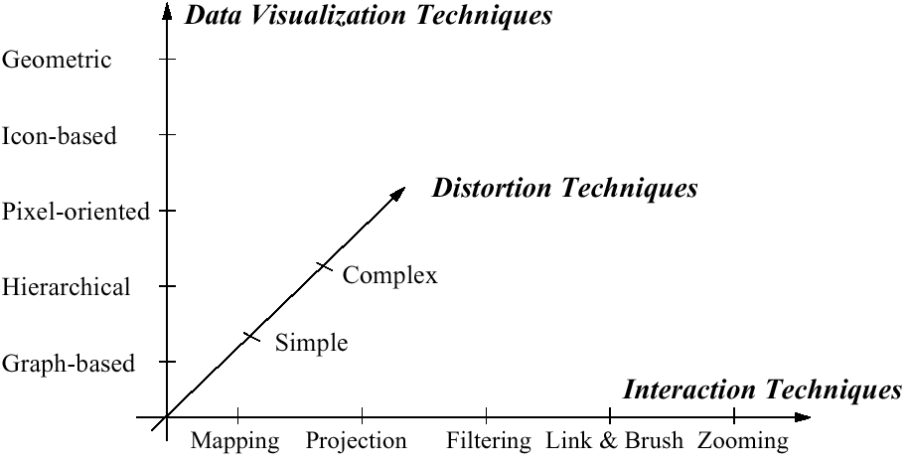
Visualization Techniques
http://www.visual-literacy.org/periodic_table/periodic_table.html
Notes:
nguyen

Slide 9
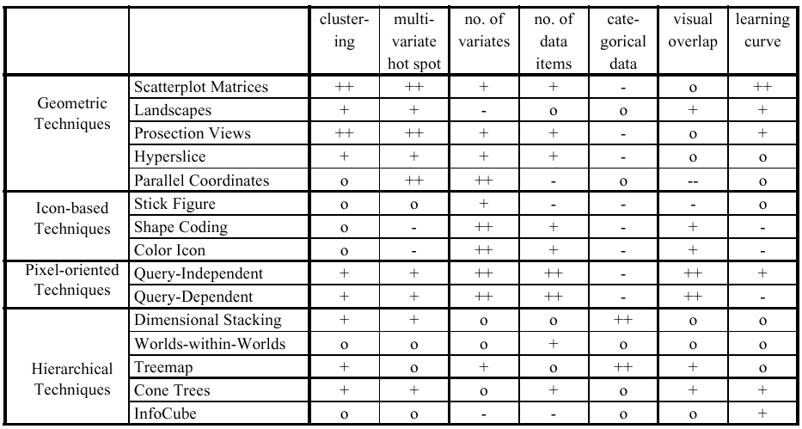
Comparison by Keim

Slide 10
Key Questions to Ask About a Visualization
What is its goal?
Does it use good design?
Have there been usability studies done? What do they show?
Notes:
(and do they match the goal?)
XX UPDATE THIS SLIDE WITH BETTER QUESTIONS

Slide 11
Does visualization help?
The jury is still out
Still supplemental at best for text collections
A correlation with spatial ability
Learning effects: with practice ability on visual display begins to equal that of text

Slide 12
The earth is getting warmer [which is closest to your view]: Create a viz
 | Sci. ‘14 | Sci. ‘09 | Aug 14 | Feb 14 | Oct 13 | Mar 13 | Oct 12 | Nov 11 | Feb 11 | Oct 10 | Sep 09 | April 09 | April 08 | Jan 07 | Aug 06 | Jul 06 | Jun 06
Mostly because of human activity | 87 | 84 | 50 | 40 | 44 | 42 | 42 | 38 | 36 | 34 | 36 | 49 | 47 | 47 | 47 | 50 | 41
Mostly because of natural patterns in the earth’s environment | 9 | 10 | 23 | 18 | 18 | 23 | 19 | 18 | 18 | 18 | 16 | 36 | 18 | 20 | 20 | 23 | 21
No solid evidence it is warming | 3 | 4 | 25 | 35 | 26 | 27 | 26 | 28 | 34 | 32 | 33 | 11 | 21 | 16 | 17 | 17 | 20
Don’t know/refused | 1 | 2 | 2 | 6 | 9 | 8 | 12 | 14 | 10 | 14 | 14 | 4 | 11 | 16 | 15 | 9 | 17

Slide 13
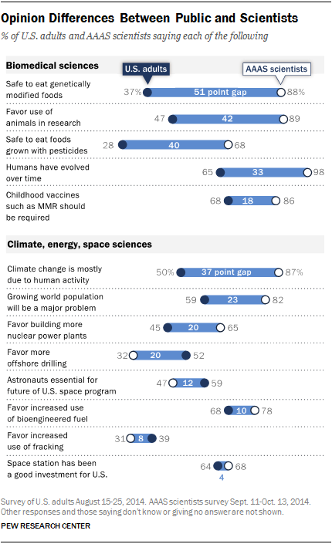
Notes:
Lightweight Visualization – what’s left out is as important as what is put in

Slide 14
Notes:
What’s even more important is what the ensured was included at the top and bottom…

Slide 15
Summary Visualization Guidelines
Set a Goal: Explore/calculate/communicate
Define visual queries/comparisons to support/stories to tell
Document process & provenance for credibility
Create highly interactive and visually integrated systems (images/words/…)
Embed the visualization within a larger application
Provide alternative views

